Slide 1
IEP Online 3.0 Writeback
Project Status Update
Where the work stands, what we have learned, and how we move toward deployment together.
09/30/26

Slide 2


Today’s Agenda
Welcome and why we are here
Writeback project overview
Project readiness summary
SIS process and responses
District interest and Cohort 1 engagement

Slide 3
Goal: Provide districts and stakeholders with a clear picture of progress, readiness, and what comes next.
Why this gathering matters
Clarity
What the project is delivering and where the work stands.
Confidence
How testing, development, and SIS response handling inform readiness.
Coordination
How PCG, WSIPC, and districts will work together on next steps.

Slide 4
Writeback project overview
A high-level view of the information flow and feedback loop.
IEP Online 3.0
District / WSIPC
Student Information System
1
2
3
Publishes the writeback file
Transfers and loads the file
Processes records and returns responses
Response loop: SIS processing results help identify records that succeeded, require review, or need correction before the next cycle.

Slide 5
How did we get here?
1
2
3
BEFORE THE 3.0 LAUNCH
Extract developed
Prior to the launch of IOL 3.0, a writeback integration extract was developed so that writeback service could continue following the 3.0 roll-out.
AFTER THE 3.0 RELEASE
Unexpected changes observed
Following the release of 3.0, a version of the writeback was generated and submitted. When reviewing writeback data against district SIS' data, a number of differences in student records were observed that were not expected.
PROTECTING DISTRICT DATA
Writeback paused
To protect known good data in district SIS', the writeback process was stopped.
On initial review of findings, and the remediation efforts required to address those findings, guidance was provided to manually update records, ensuring they were correct for start of school counts.

Slide 6
Initial remediation strategy – 2 parallel efforts
WORKSTREAM 1
Develop a manual file for the start of counts
Approach
Using enrollment data from IOL 3.0, along with student special education data submitted across multiple 2.0 writeback files, we manually constructed a writeback file for upload consideration.
RESULT
Although not perfect, data looked directionally good
However, broad verification was not possible in the window needed.
Complicating factors:
Users were updating student data directly in their SIS
Users were updating student data directly in 3.0
Ongoing enrollment changes at the start of the year shifted scope heavily
DECISION
To protect work done by district staff and avoid confusion during a critical count window, we opted to not load the manual writeback file.

Slide 7
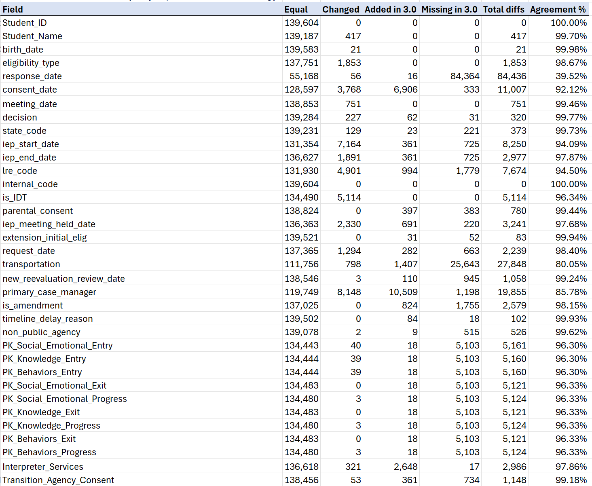
Initial remediation strategy – 2 parallel efforts
WORKSTREAM 2
Identify and correct data representation in the 3.0 automated writeback
Conduct audit of data modeling
  Update, re-migrate, and re-map problem data elements
  Developing new backend representations to avoid conflicts with user activities in 3.0
Conduct audit of extraction logic
Large-scale regression testing against 2.0 data (~140,000 separate records tested)
Scenario and rules testing

Slide 8
The path forward
A deliberate sequence of reconstruction, protection, refinement, and validation.
Define our baseline
Identified 2.0 writeback files to reference as our best known good, developing matching logic accounting for SIS changes, transfers, and common year-end shifts in data.
1
1
Reconstruct a stable benchmark
Constructed a version of 3.0 enrollment records with 2.0 data, and developed a process for large scale regression testing.
2
2
Protect current work
Adjusted modeling and report logic to avoid overwriting valid 3.0 values or user-entered updates.
3
3
Iterate and regression test
Compared automated versions to the stable benchmark, tested mapped scenarios, and examined student-level changes.
4
4
District review
The further we get into the school year, the less reliable 2.0 data is for testing student record accuracy. District feedback is essential to validating writeback readiness.
5
5

Slide 9
SIS process and responses
1
2
3
File received
Records evaluated
Follow-up taken
How the SIS receives and initiates processing of the writeback file.
What response categories districts may see after processing.
Who reviews exceptions, how corrections are coordinated, and what is communicated.

Slide 10
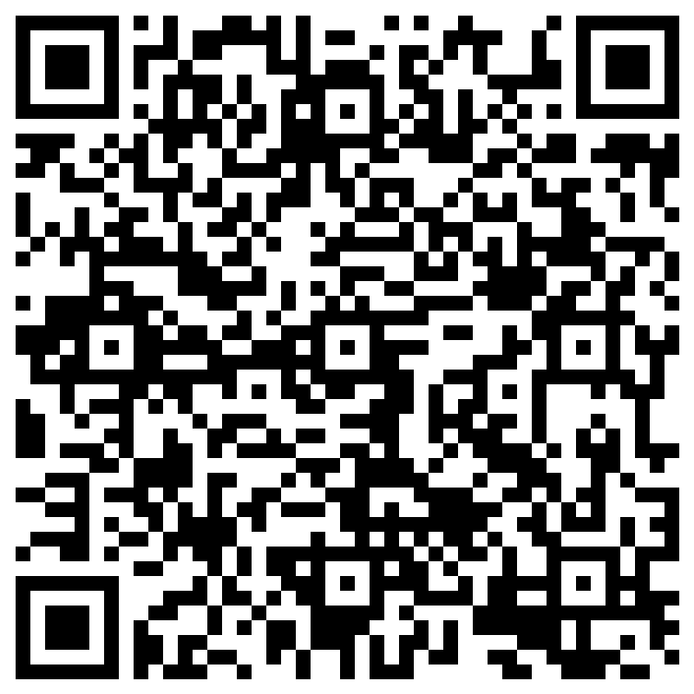
Writeback Pilot: Engagement & Interest
Participation is voluntary. PCG and WSIPC will support each Pilot district at every step.
What participation includes
Questions for districts
What happens next
Plan a deployment window
Review your districts writeback data for accuracy
Monitor initial SIS processing results
Share timely feedback with PCG and WSIPC
Weekly Check-Ins with the pilot districts to share feedback
Are you interested in joining the Pilot ?
Who will coordinate for your district?
What support would help you participate?
We are looking for 10% of Writeback Districts to be included in the pilot
Submit your interest by 10/1
We confirm participants by 10/2
Initial pilot kickoff meeting 10/6
Interested?
Skyward districts
Scan the QR code to fill out the district interest form.
Non-Skyward districts
Email sdoyle@pcgus.com and CustomerSupport@pcgus.com with the subject “Writeback Pilot Interest.”

Slide 11
Next steps for every district
What happens after today, whether or not your district joins the Pilot.
Pilot districts
If you opt in
Send PCG and WSIPC interest by 10/1
Hear about selection by 10/2
Plan your deployment window and review writeback data
Monitor initial SIS results and share feedback with PCG and WSIPC
All other districts
If you do not opt in now
Continue your current process; no action needed today
Receive weekly updates on Pilot progress and any timeline impacts
Prepare for general go-live (see next slide)
Reach out with questions at any time
Questions after today? Email sdoyle@pcgus.com and ieponline@wsipc.org

Slide 12
Go-live planning
What every district can expect as the writeback moves from the Pilot to full go-live.
01
Pilot review
Share weekly pilot progress with all districts via the 3.0 dashboard, including any impacts on the delivery timeline.
Ongoing
02
Weekly full files for the pilot districts
Work with the pilot districts to start processing their files and test
03
Daily file runs for all districts
Set the timeline for daily writeback file runs.
Start: 10/26/26
We will keep every district informed of timing as the pilot review progresses.

Slide 13
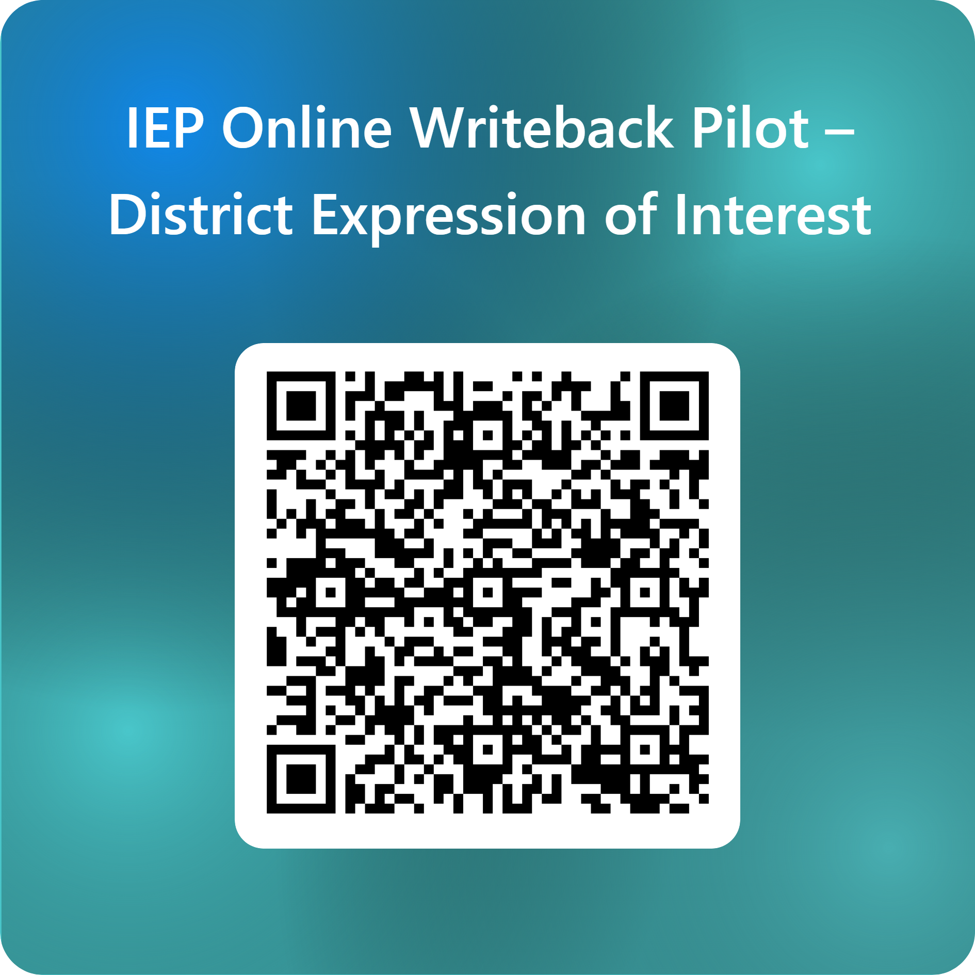
Questions?
Reach us at CustomerSupport@pcgus.com | ieponline@wsipc.org
Skyward Districts
Non-Skyward Districts
Scan the QR code to fill out the district interest form.
Email PCG to express interest
CustomerSupport@pcgus.com
and
sdoyle@pcgus.com

